Slide 1



Data-Driven Decisions in Retention Planning
by Selom Sessou

Slide 2
Introduction:
Growth
Loss
Over the past several decades, the Seventh-day Adventist Church has experienced both remarkable growth and painful loss.
While baptisms increase year after year, a significant percentage of those baptized are no longer active members.

Slide 3
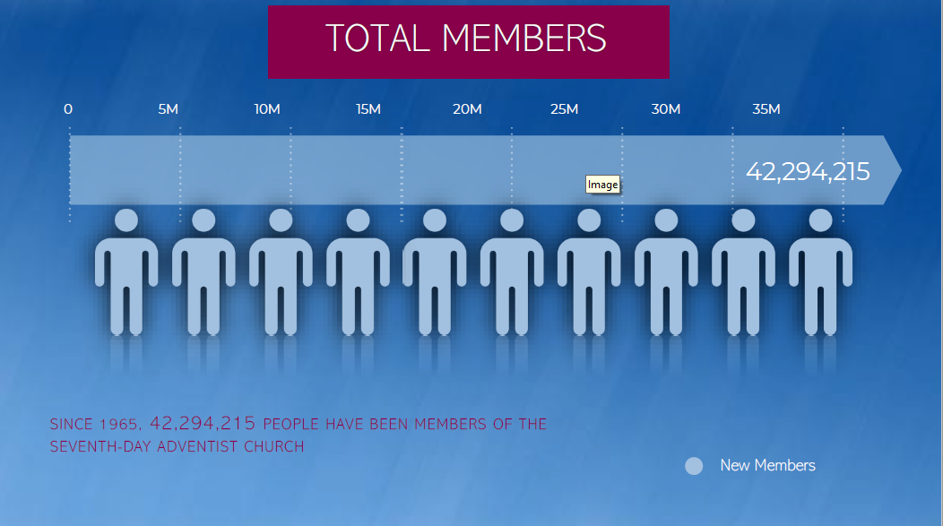

Slide 4
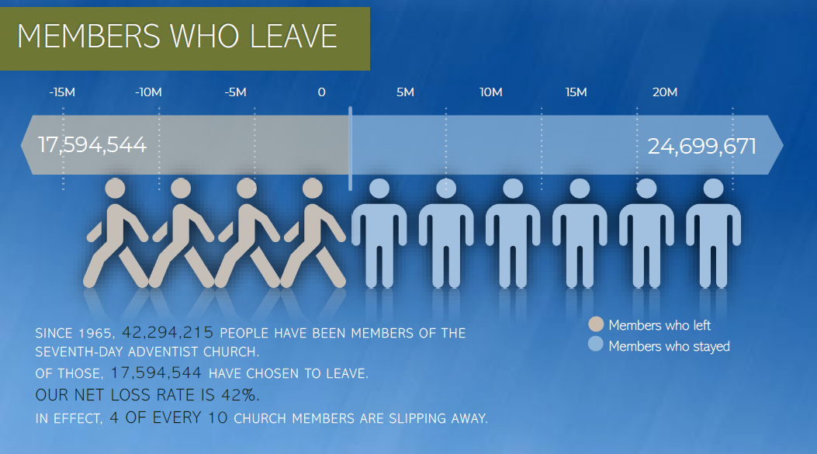

Slide 5


West-Central Africa Division (WAD) Context
Membership Audit Discrepancy
In many unions and local missions/conferences, membership audit reveals a discrepancy between baptized members and those participating in church life.

Slide 6
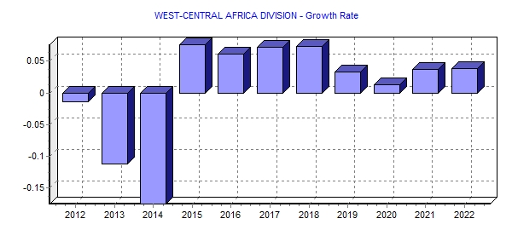
Item | 2012 | 2013 | 2014 | 2015 | 2016 | 2017 | 2018 | 2019 | 2020 | 2021 | 2022
Growth Rate | 866,254 | 769,607 | 635,064 | 683,318 | 725,045 | 776,837 | 834,183 | 862,027 | 873,579 | 905,667 | 940,203
Membership
Item | 2012 | 2013 | 2014 | 2015 | 2016 | 2017 | 2018 | 2019 | 2020 | 2021 | 2022
Growth Rate | -1.37% | -11.16% | -17.48% | 7.60% | 6.11% | 7.14% | 7.38% | 3.34% | 1.34% | 3.67% | 3.81%

Slide 7
GAINS vs LOSS – WAD [2022-2024]
39 830
59 509
41 626

Slide 8

WAD
Current Membership (1QT 2025)
1,077,337

Slide 9
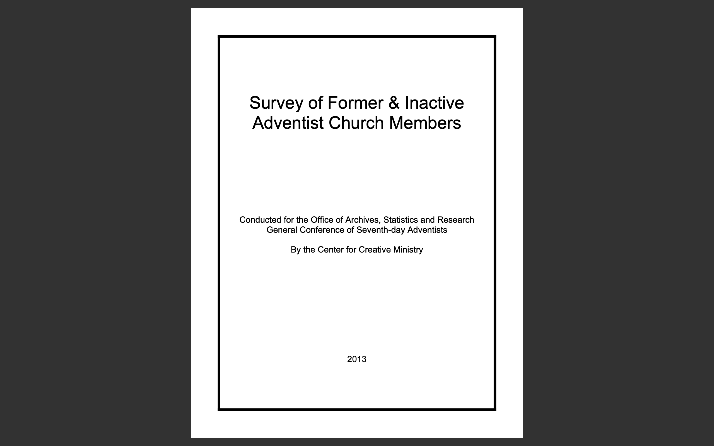

Slide 10
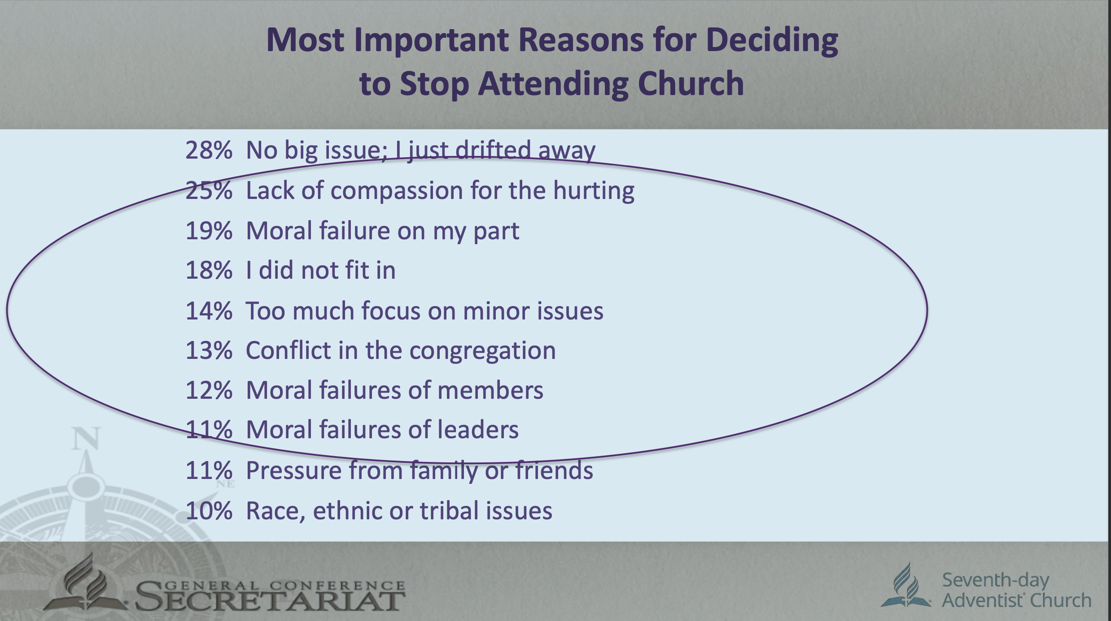

Slide 11
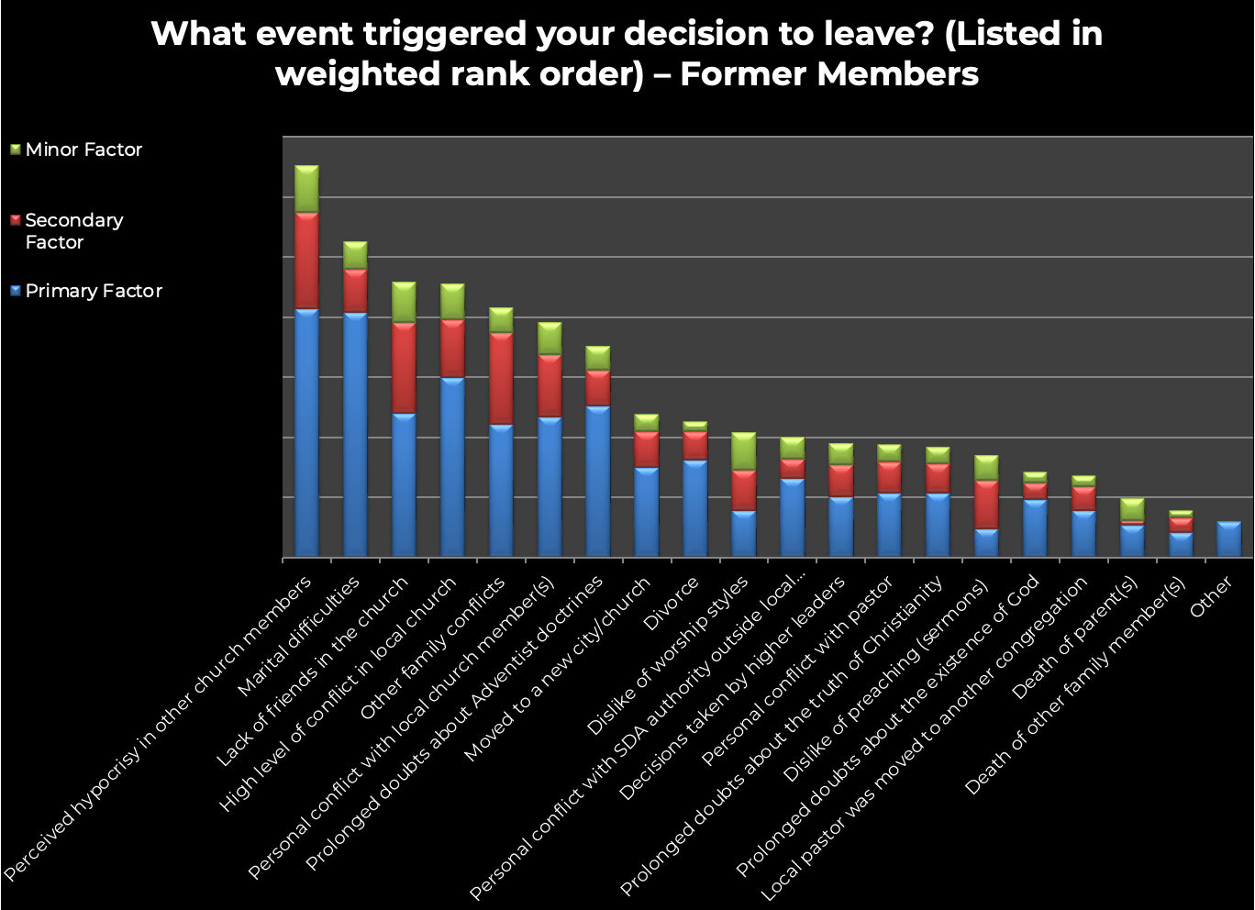

Slide 12
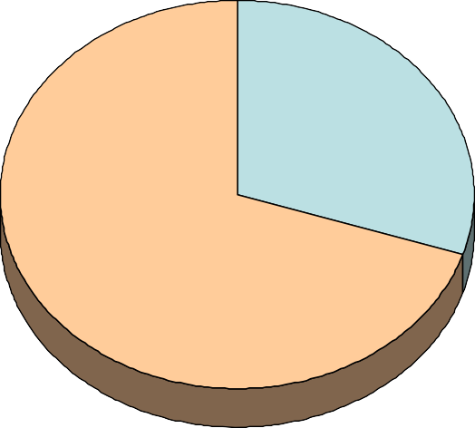
How their Relationship with the Adventist Church Began
Raised an Adventist 30%
Converts 70%
Of the inactive and former Adventists interviewed, 30 percent stated that they were raised in an Adventist family as a child, while 70 percent converted to the Seventh-day Adventist Church as adolescents or adults.

Slide 13
First Contact with the Seventh-day Adventist Church
30% Raised as an Adventist
28% Through a friend, relative, neighbor or coworker
23% Through public evangelism
8% Someone going door to door
4% Through an Adventist school
4% From literature
2% Humanitarian and health ministries
2% Through an Adventist institution
1% From a music group
1% From the Internet
>% From a radio or television ministry
4% Other things

Slide 14
First Contact with the Seventh-day Adventist Church
Although the largest number of inactive and former members were raised as an Adventist, almost as many told the interviewers that they first came into contact with the Seventh-day Adventist Church through a friend, relative, spouse or other acquaintance. Together these two avenues account for the majority of these cases, demonstrating how important relationships are to church growth and retention.
Less than a quarter of the individuals interviewed indicated that their first contact with the Adventist message was through public evangelism. This undercuts the common view of many church members that retention issues are largely rooted in the inability of public evangelism to adequately prepare new members for baptism or allow for sufficient bonding with the congregation. More than three out of four of the inactive and former members in this study did not come into the church by first hearing of it and then immediately being baptized in an evangelism campaign.

Slide 15
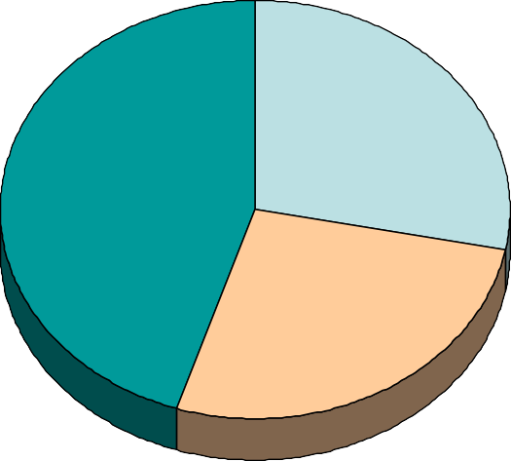
Religion Before Joining the Seventh-day Adventist Church
The majority of the inactive and former Adventists interviewed were either raised as an Adventist or had no religious affiliation before they joined the Adventist Church. Only 45 percent of the individuals interviewed named some other religion they belonged to prior to becoming an Adventist. The largest numbers—nine percent in each case—were Roman Catholics or Pentecostals.
Religion Before Joining the Seventh-day Adventist Church
Raised an Adventist 28%
Named a religion 45%
No religion 27%

Slide 16
What most attracted you when you decided to join the Adventist Church?
Those who leave the Adventist Church are most likely to identify the “truth and beauty of Church teachings” as the strongest motivation for them to join the Church. The “warmth and friendship of church members” and the “charisma of the evangelist or pastor” are also remembered as strong motivations at the time they joined the Church.
What most attracted you when you decided to join the Adventist Church?
Friendship 12%
31%
56%
Doctrines 7%
21%
72%
Charisma of preacher
19%
29%
52%
My needs
40%
23%
37%
Little or no attraction Some attraction Much attraction

Slide 17
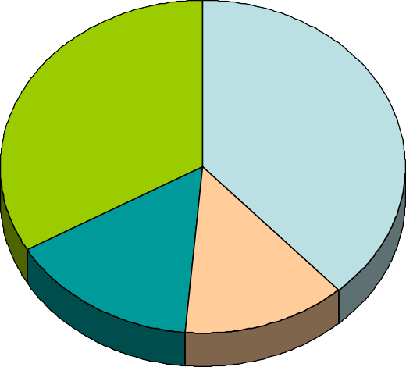
Time from First Contact to Baptism
These interviews do provide some evidence that baptizing a person “too soon” may have something to do with why large numbers become inactive or leave the church. A slim majority told the interviewers that the time from their first contact with the Adventist Church to their baptism was two years or less. The largest number of these (29 percent of the total sample) said that it was six months or less.
Time from First Contact to Baptism
Five years or more 33%
Less than a year 39%
Three or four years 15%
One or two years 13%

Slide 18
How would you describe the instruction given when you joined the church?
There is little evidence that the former and inactive members interviewed had insufficient baptismal preparation and new-member orientation, at least in their estimation. The majority said that the instruction they were given before and immediately after joining the Adventist Church was “very thorough (more than I had expected)” or “thorough enough that I had no surprises after becoming a member.” One in four reported that the instruction was “enough to answer my questions, but not overwhelming.” Less than one in five stated that it was “inadequate (I felt rushed and there were surprises later on)” or “very little.”
How would you describe the instruction given when you joined the church?
Very thorough
19%
Thorough
38%
Enough
24%
Inadequate
11%
Very little
8%

Slide 19
How would you describe the instruction given when you joined the church?
A long-standing myth is that church dropouts are related to pastors and evangelists who do not adequately prepare candidates for baptism. Previous research has shown that this is largely untrue. The evidence on this page supports that previous research.
How would you describe the instruction given when you joined the church?
Very thorough
19%
Thorough
38%
Enough
24%
Inadequate
11%
Very little
8%

Slide 20
Age When First Started Attending the Adventist Church
The 26 percent of those interviewed who indicated that they started attending an Adventist church when they were under 10 years of age overlaps with the 30 percent who responded to an earlier question by reporting that they were raised as an Adventist. The majority of the inactive and former members were teens and young adults when they joined the Adventist Church. Only 14 percent were 30 years of age or older when they stated attending an Adventist church.
Age When First Started Attending the Adventist Church
38%
26%
23%
9%
5%
Under age 10 Ages 10-17 Ages 18-29 Ages 30-39 Age 40 and
older

Slide 21
Age When First Started Attending the Adventist Church
One explanation for these data is that people are converted to the Adventist Church when they are quite young and then face a number of normal transitions in life which cause them to lose connection with the Church. A similar—and perhaps mingled—explanation is that a large share of these converts do not make a mature commitment to the Adventist Church and leave as their spiritual needs mature and their thinking changes.
Age When First Started Attending the Adventist Church
38%
26%
23%
9%
5%
Under age 10 Ages 10-17 Ages 18-29 Ages 30-39 Age 40 and
older

Slide 22
Age When Stopped Attending the Adventist Church
About half of the inactive and former members interviewed stop attending the Adventist Church before they turned 30 and almost an equal number did so after turning 30.
Age When Stopped Attending the Adventist Church
37%
29%
15%
10%
Under age 18
Ages 18-29
Ages 30-39 Age 40 and older

Slide 23
Age When Stopped Attending the Adventist Church
The half of the church dropouts who left the church while still in their teen and young adult years could be understood to have lost contact because of the transitions that characterize this age group. These include leaving home to attend school or finding employment, discovering new ideas and perceptions in the process of education, joining the military or a similar experience, engaging in travel, and starting a family or entering into relationships that may cause shame (even privately) at church. In many parts of the world there is significant migration among young people from rural villages and small towns to large cities and this transition has been documented in previous research as a key factor in young Adventists losing contact with the Church.
Age When Stopped Attending the Adventist Church
37%
29%
15%
10%
Under age 18
Ages 18-29
Ages 30-39 Age 40 and older

Slide 24
Number of Years Regularly Attended an Adventist Church
Only nine percent of the inactive and former members interviewed had attended an Adventist church for a year or less. Two thirds had attended an Adventist church for five years or longer before they dropped out. Only about one in four reported attending less than five years. These data clearly indicate that the retention issues among Seventh-day Adventists have little to do with the common theory that the methods of evangelism used do not provide for sufficient time for instruction and bonding with the congregation. Clearly the issues related to retention occur for most people after they have had sufficient time to become fully a part of the Adventist Church.
Number of Years Regularly Attended an Adventist Church
27%
21%
17%
13%
9%
5%
One year Two to Five to
10 to 19 20 to 29 30 or more years years years
or less four years nine years

Slide 25
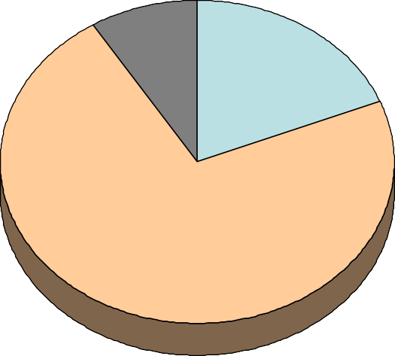
Held a Volunteer Leadership Role in the Adventist Church
Less than one in five former and inactive members have ever served as a local church officer or held some other volunteer position in the Seventh-day Adventist Church. A number of surveys in North America and other world divisions have resulted in a significantly higher percentage among active members. This suggests that there may be some correlation between involving members in volunteer work for the church and retention. Further research will be necessary to confirm this possibility and qualitative research will be necessary to understand the dynamics involved. Correlation, if it exists, is not proof of causation.
Held a Volunteer Leadership Role in the Adventist Church
Yes 19%
No 72%
About eight percent of the interviewees could not remember.

Slide 26
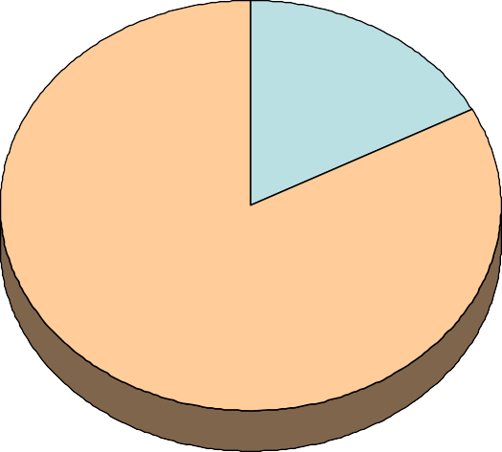
Attended an Adventist School
Only one in six of the inactive and former members interviewed reported that they had ever attended an Adventist school. About six percent had attended an Adventist primary or elementary school at some point in their life. About seven percent had attended an Adventist secondary school and eight percent had attended an Adventist college or university.
Attended an Adventist School
Yes 17%
No 83%

Slide 27
Attended an Adventist School
Clearly, attendance at an Adventist school is not strongly associated with dropouts. Previous research has often shown that attendance at Adventist schools is correlated with retention, while some studies show otherwise at least for certain levels of education. Much of this research included samples only from parts of the world. Further research is needed to determine precisely how Adventist education relates to membership retention.
Attended an Adventist School
Yes 17%
No 83%

Slide 28
Community Context of the Local Church they Last Attended
More than a third of the inactive and former members interviewed (36 percent) indicated that the Adventist Church they last attended was located in an urban area; a city of more than 50,000 population or the suburbs of a city or in the “downtown” or central area of a large city. This means that nearly two thirds of these people dropped out of a church located outside of a metropolitan area. Because the majority of the world’s population now live in urban areas, this may be a significant indicator. Are retention problems related to people moving from small towns, villages and rural areas to the cities? Do we have sufficient congregations and pastoral personnel in the cities to reach out to members as they make this transition and keep them connected with the Church? Are there procedures in place to communicate the fact that members are moving?
Community Context of the Local Church they Last Attended
29%
19%
16%
14%
16%
6%
Rural area Village Small town
City
Suburb City center

Slide 29
Life Events in the Year Leading Up to Decision to Stop Attending
Three out of four of the inactive and former members interviewed (74 percent) reported at least one of these stressful life events as having occurred in the year before they decided to quit attending the Adventist Church. The majority reported more than one event. These data track with previous research in North America that correlates church dropout behavior with a two-part dynamics; a cluster of stressful life events that destabilizes a church member’s relationship with the church and then the congregation’s failure to respond with adequate understanding and care for the stress being experienced by the member. This is a dynamic that may be the most important factor in member retention, but even pastors and lay leaders, furthermore the people in the pews, are widely ignorant of this reality.
Life Events in the Year Leading Up to Decision to Stop Attending
Serious illness Married/ divorced
Moved to new town
10%
11%
10%
15%
Death in family
8%
Marital conflict Graduation Job change
Famine-poverty Illness in family
Lost job Birth or adoption Child left home Legal problems
Immigrated
7%
7%
6%
6%
2%
3%
1%
1%
0.4%
0.3%
Disaster or war
Other None of these
8%
26%

Slide 30
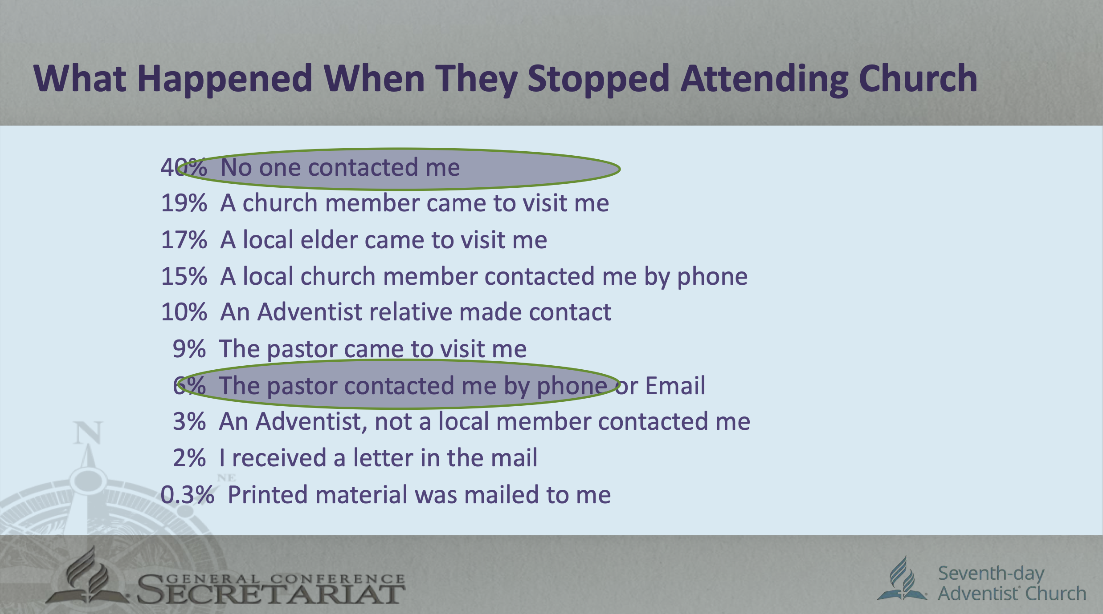

Slide 31
What Happened When They Stopped Attending Church
The largest number of the inactive and former members interviewed stated that when they stopped going to church no one from the church contacted them. Previous research in North America has reported that most church dropouts are uncontested. Pastors and congregations most often simply let the non-attending members slip away.

Slide 32
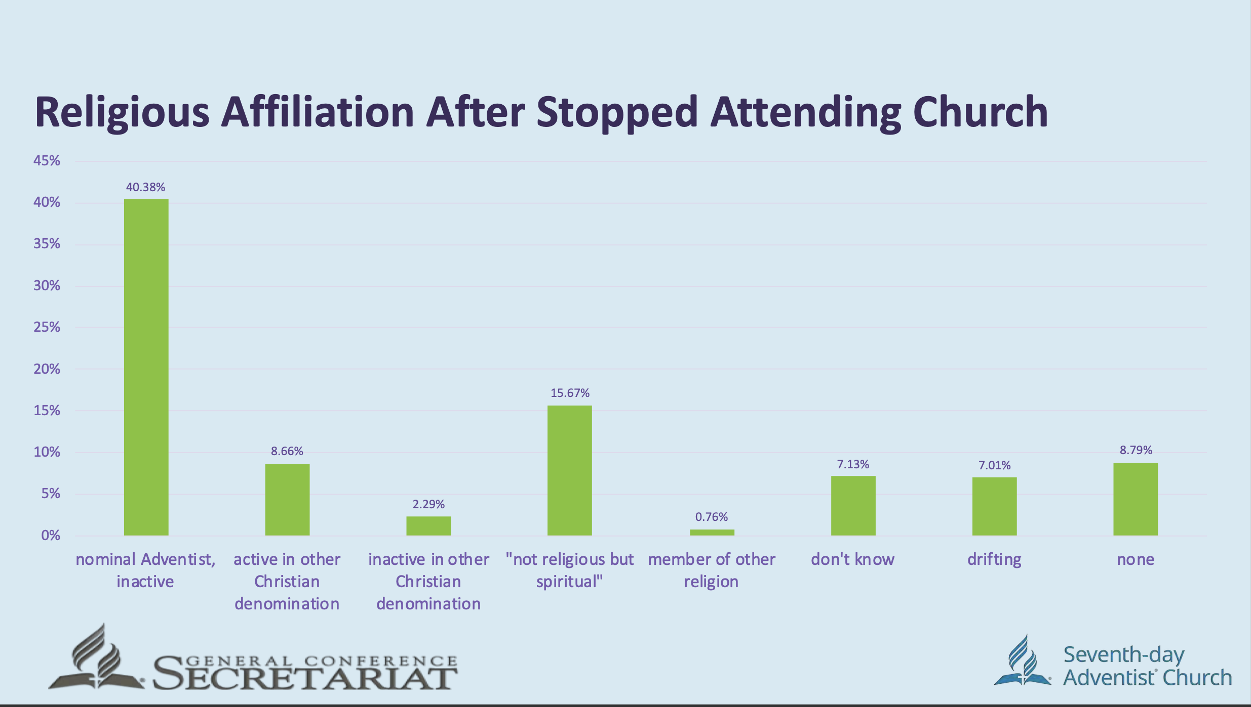

Slide 33
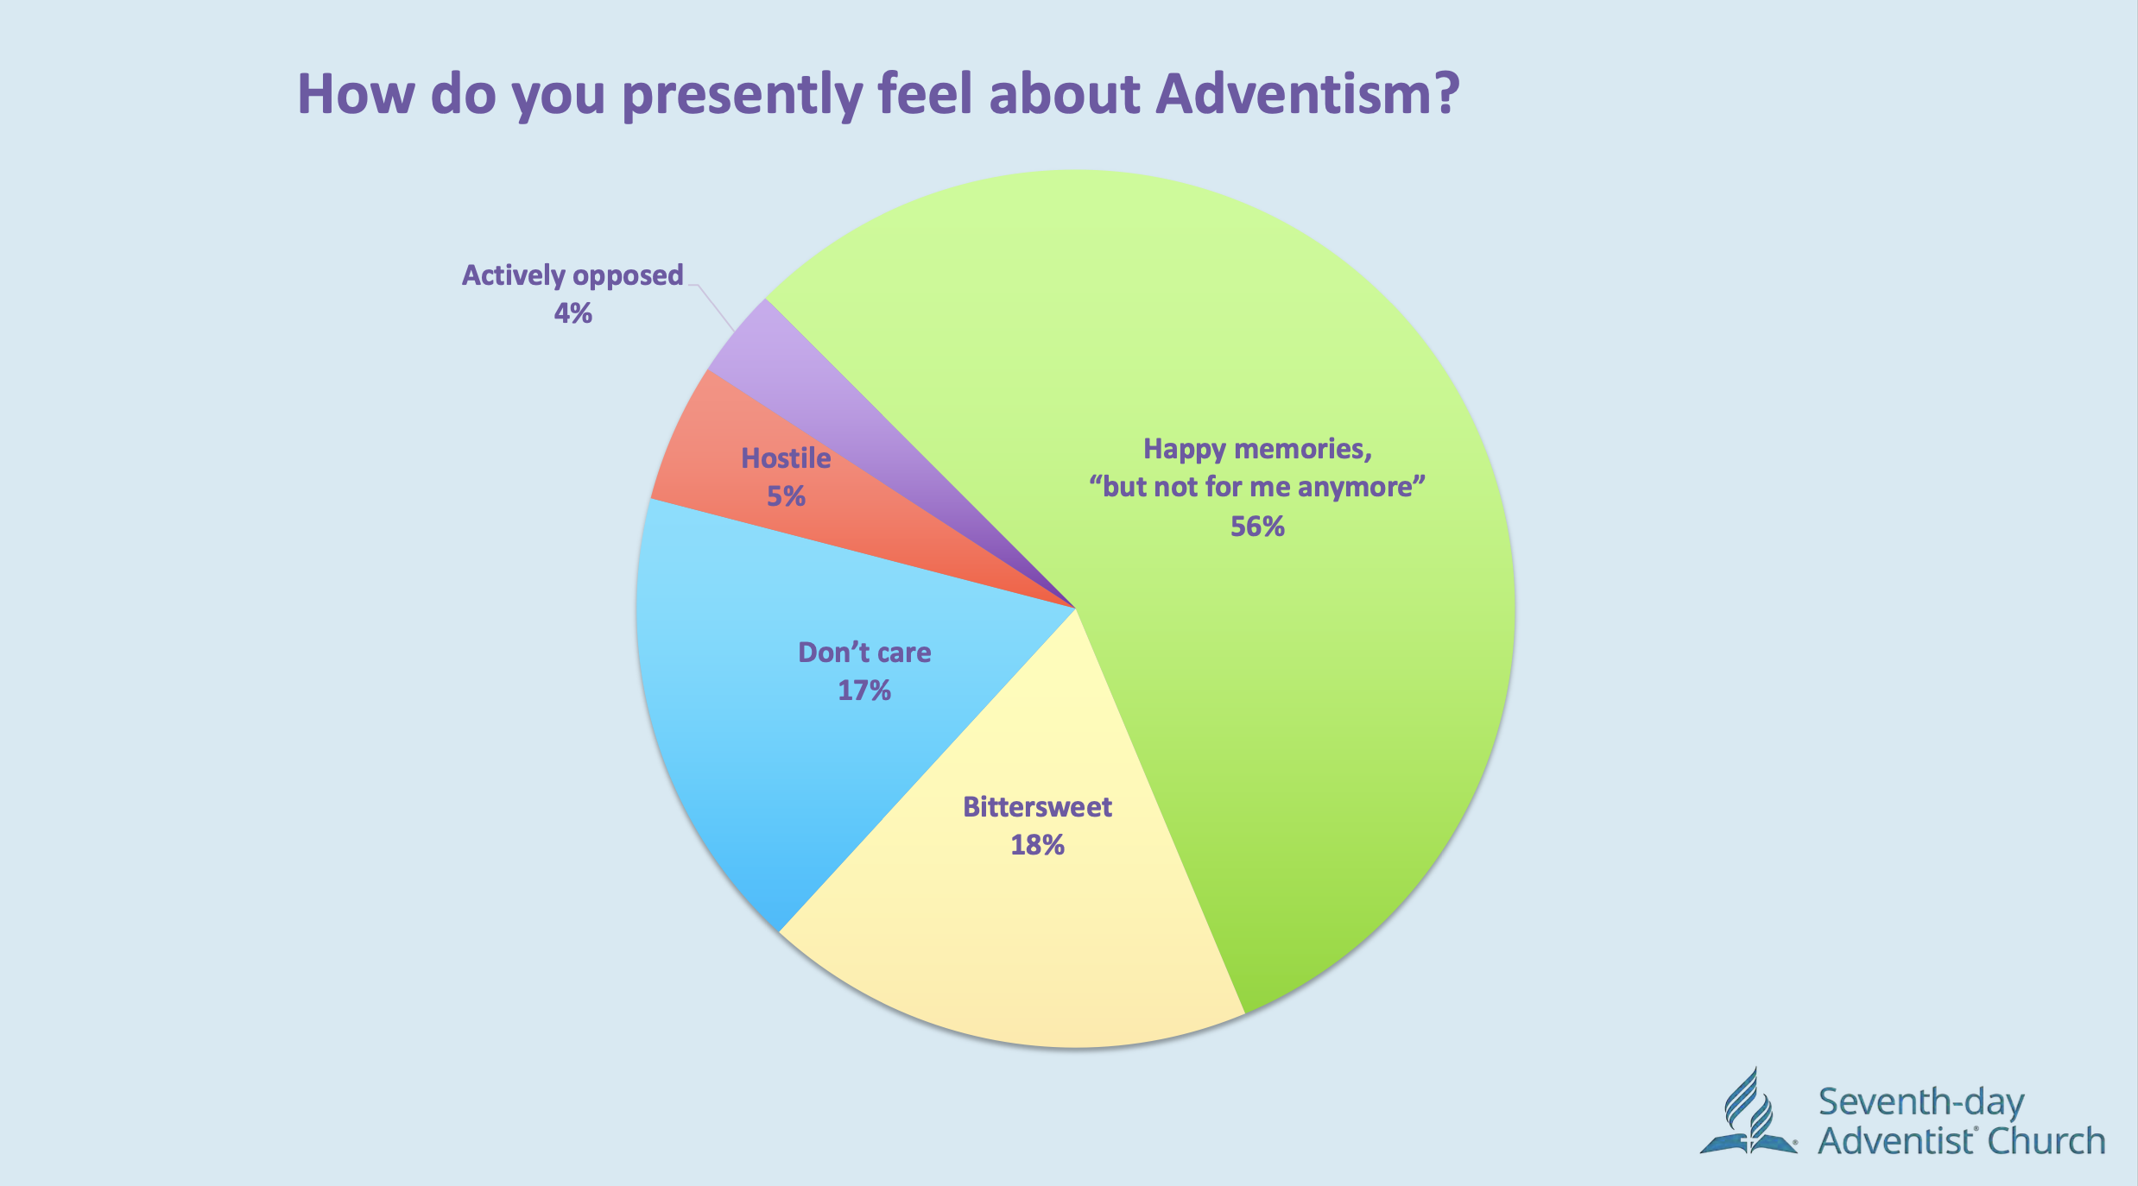

Slide 34
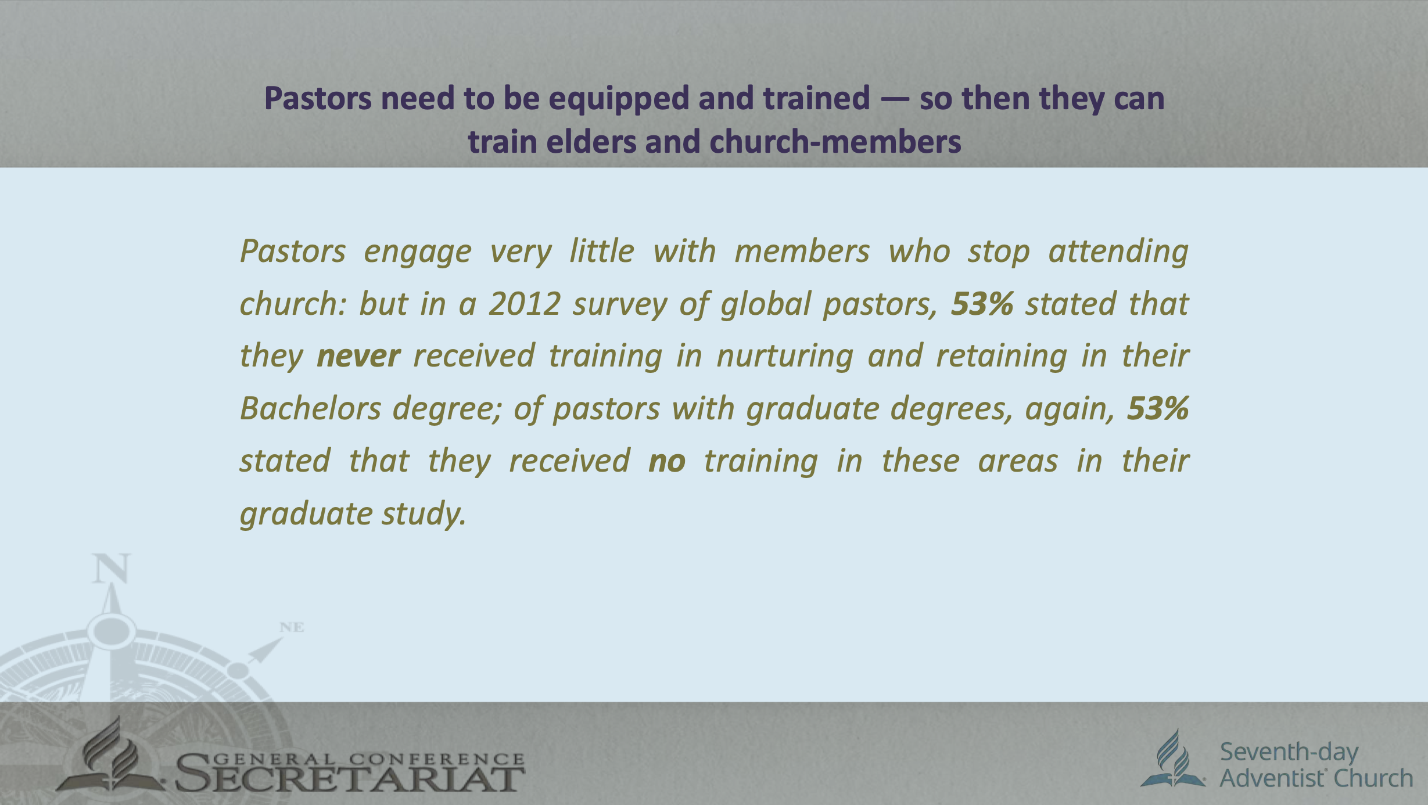

Slide 35

Why Data Matters in Retention Planning
Jesus told the parable of the lost sheep (Luke 15:1–7), emphasizing that even one lost soul matters to heaven. The shepherd didn't guess—he counted and knew one was missing. That's data-driven pastoring.

Slide 36
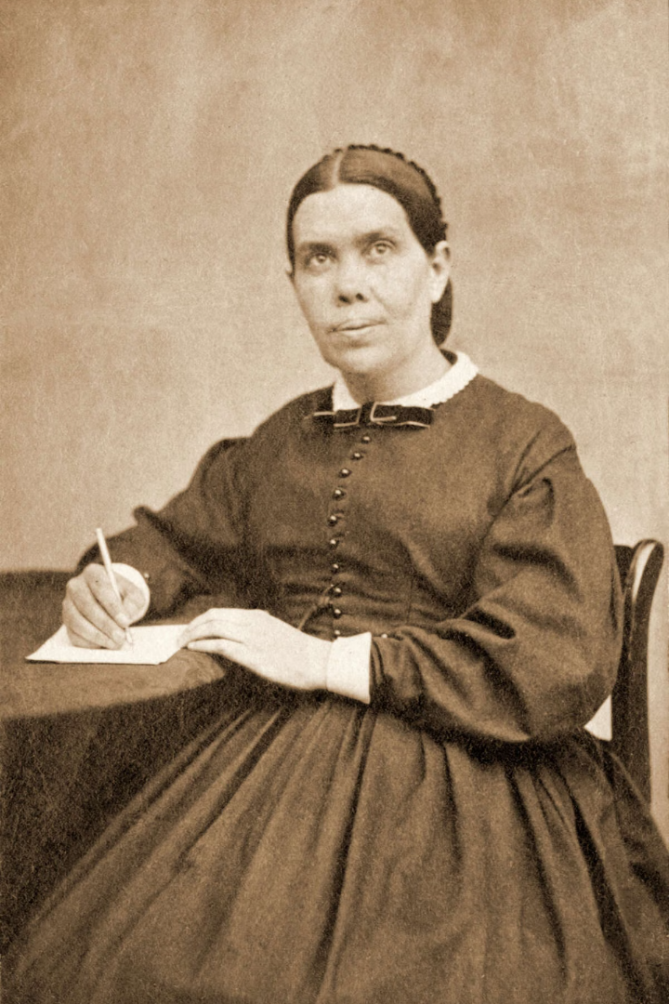

Ellen G. White Insight
Stewards of Sacred Truth
"God has made His people stewards of sacred truth. He calls upon them to act with wisdom, to plan, to watch, to pray, and to work with painstaking effort to retain those who accept the truth." — Evangelism, p. 345

Slide 37





Strategic Benefits of Data
Early Identification
Helps us identify at-risk members early
Evidence-Based Decisions
Enables evidence-based decision-making rather than assumptions
Resource Allocation
Guides the allocation of resources—time, personnel, budget—for maximum impact
Customized Discipleship
Allows for customized discipleship pathways
Accountability
Fosters accountability and continuous improvement

Slide 38
What Retention Data Should We Track?
Quantitative Metrics
Qualitative Metrics
Baptism and membership growth rates
Member satisfaction surveys
Spiritual growth assessments
Attendance trends (Sabbath School, Divine Service, Small Groups)
Relationship strength and connectedness
Transfer in/out rates
Engagement in ministries and small groups
Dropout/missing member statistics

Slide 39








Building a Culture of Retention
Collect
Collect relevant member data consistently (via Nurture & Retention Committees, ASTR tools, etc.)
Analyze
Analyze to find patterns and pain points
Act
Evaluate
Act through targeted interventions (home visits, mentoring, Bible classes, small groups)
Evaluate the effectiveness and refine the plan

Slide 40


Practical Examples
Discover the Problem
A mission might discover that 60% of dropouts occurred among youth aged 18–25.
Develop Solutions
This data can inform a plan to develop youth mentorship programs, educational support, or small group discipleship.

Slide 41

Practical Examples (Continued)
Identify Decline
A local church sees declining Sabbath School attendance.
Gather Feedback
Targeted interviews and tracking help discover that people feel the classes are not engaging.
Implement Change
Reforms are made based on the feedback.

Slide 42

A Call to Action for Leaders
Pastors and Elders
Pastors and Elders must be trained to use data tools and think analytically about member care.
Secretaries and Clerks
Secretaries and clerks should ensure membership records are accurate and up-to-date.
Union/Conference Administrators
Union/Conference Administrators should incorporate retention goals into strategic plans.
Departmental Leaders
Departmental leaders should use data to personalize ministry.

Slide 43

From Reactive to Intentional
The time has come to move from reactive responses to intentional, data-driven retention strategies.

Slide 44
From Reactive to Intentional
Data is not just numbers—it's a window into the spiritual lives of God's people, calling us to shepherd more faithfully.

Slide 45



Conclusion
Final Charge: If we are to fulfill the Great Commission not just to baptize, but to make disciples, we must move from emotional responses to intentional planning. The Holy Spirit uses both prayer and planning. Data, when consecrated to God, becomes a tool of grace.

Slide 46

Quote to Close
The Purchase of Christ's Blood
"The work of winning souls is not to be done hurriedly or carelessly. Each soul is to be cared for as the purchase of the blood of Christ." — Testimonies for the Church, Vol. 6, p. 400

