Slide 1
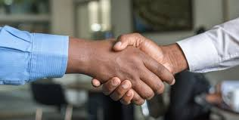
LITERATURE EVANGELISM CANVASSING
TRAINING PROGRAM
SIERRA LEONE CONFERENCE
2025

Slide 2
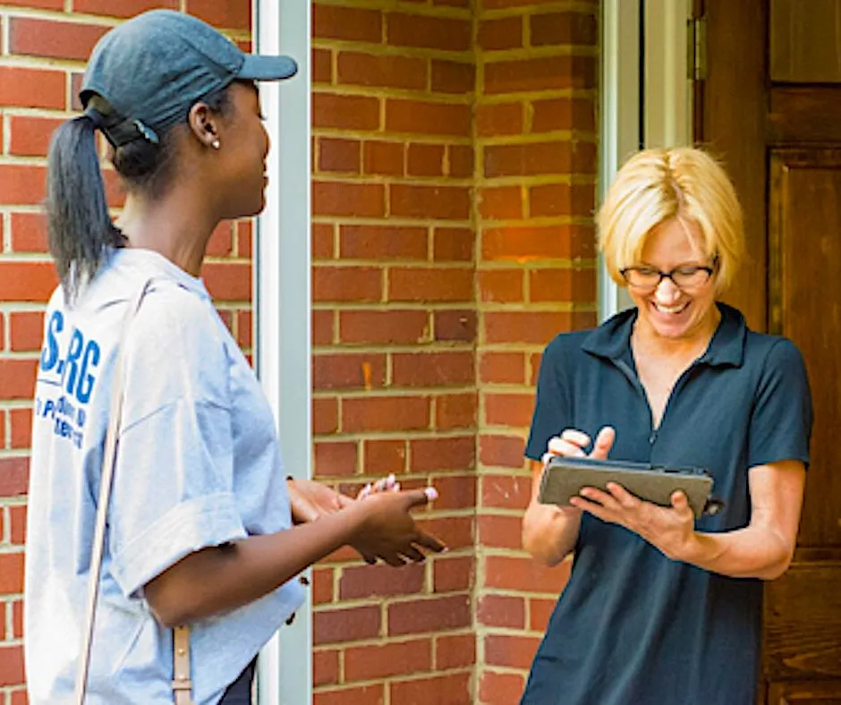
Canvassing
From Wikipedia, the free encyclopedia
Canvassing is the systematic initiation of direct contact with individuals commonly used during political campaigns. Campaigners will knock on doors or make telephone calls (also known as phone banking) to engage in a personalized contact with an individual.

Slide 3
Colporteur work.
A Work Ordained of God—God has ordained the canvassing work as a means of presenting before the people the light contained in our books, and canvassers should be impressed with the importance of bringing before the world as fast as possible the books necessary for their spiritual education and enlightenment.

Slide 4
Colporteur work.
This is the very work the Lord would have His people do at this time. All who consecrate themselves to God to work as canvassers are assisting to give the last message of warning to the world. We cannot too highly estimate this work; for were it not for the efforts of the canvasser,

Slide 5
Colporteur work.
As a people we are to be reconverted, our lives sanctified to declare the truth as it is in Jesus. In the work of scattering our publications, we can speak of a Saviour’s love from a warm and throbbing heart. God alone has the power to forgive sins; if we do not speak this message to the unconverted, our neglect may prove their ruin....

Slide 6
Colporteur work.
The Lord calls upon all of us to seek to save perishing souls. Satan is at work to deceive the very elect, and now is our time to work with vigilance. Our books and papers are to be brought before the notice of the people; the gospel of present truth is to be given to our cities without delay. Shall we not arouse to our duties?—Testimonies for the Church 9:62, 63 (1909).

Slide 7
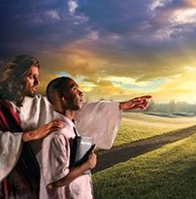
Colporteur work.
Those Who Feel Burden of Service—Since canvassing for our literature is a missionary work, it should be conducted from a missionary standpoint. Those selected as canvassers should be men and women who feel the burden of service, whose object is not to get gain, but to give light to the people. All our service is to be done to the glory of God, to give the light of truth to those who are in darkness. Selfish principles, love of gain, dignity, or position, should not be once named among us.—Testimonies for the Church 6:317 (1900).

Slide 8
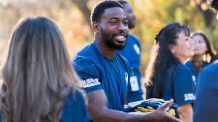
Colporteur work.
Some are better adapted than others for doing a certain work; therefore, it is not correct to think that everyone can be a canvasser. Some have no special adaptability for this work; but they are not, because of this, to be regarded as faithless or unwilling. The Lord is not unreasonable in His requirements. The church is as a garden in which is a variety of flowers, each with its own peculiarities.
Though in many respects all may differ, yet each has a value of its own.

Slide 9
Colporteur work.
Everyone is not fitted for this work.
Those of the best talent and ability, who will take hold of the work understandingly and systematically, and carry it forward with persevering energy, are the ones who should be selected. There should be a most thoroughly organized plan; and this should be faithfully carried out. Churches in every place should feel the deepest interest in the tract and missionary work.—Testimonies for the Church 4:390 (1880).

Slide 10
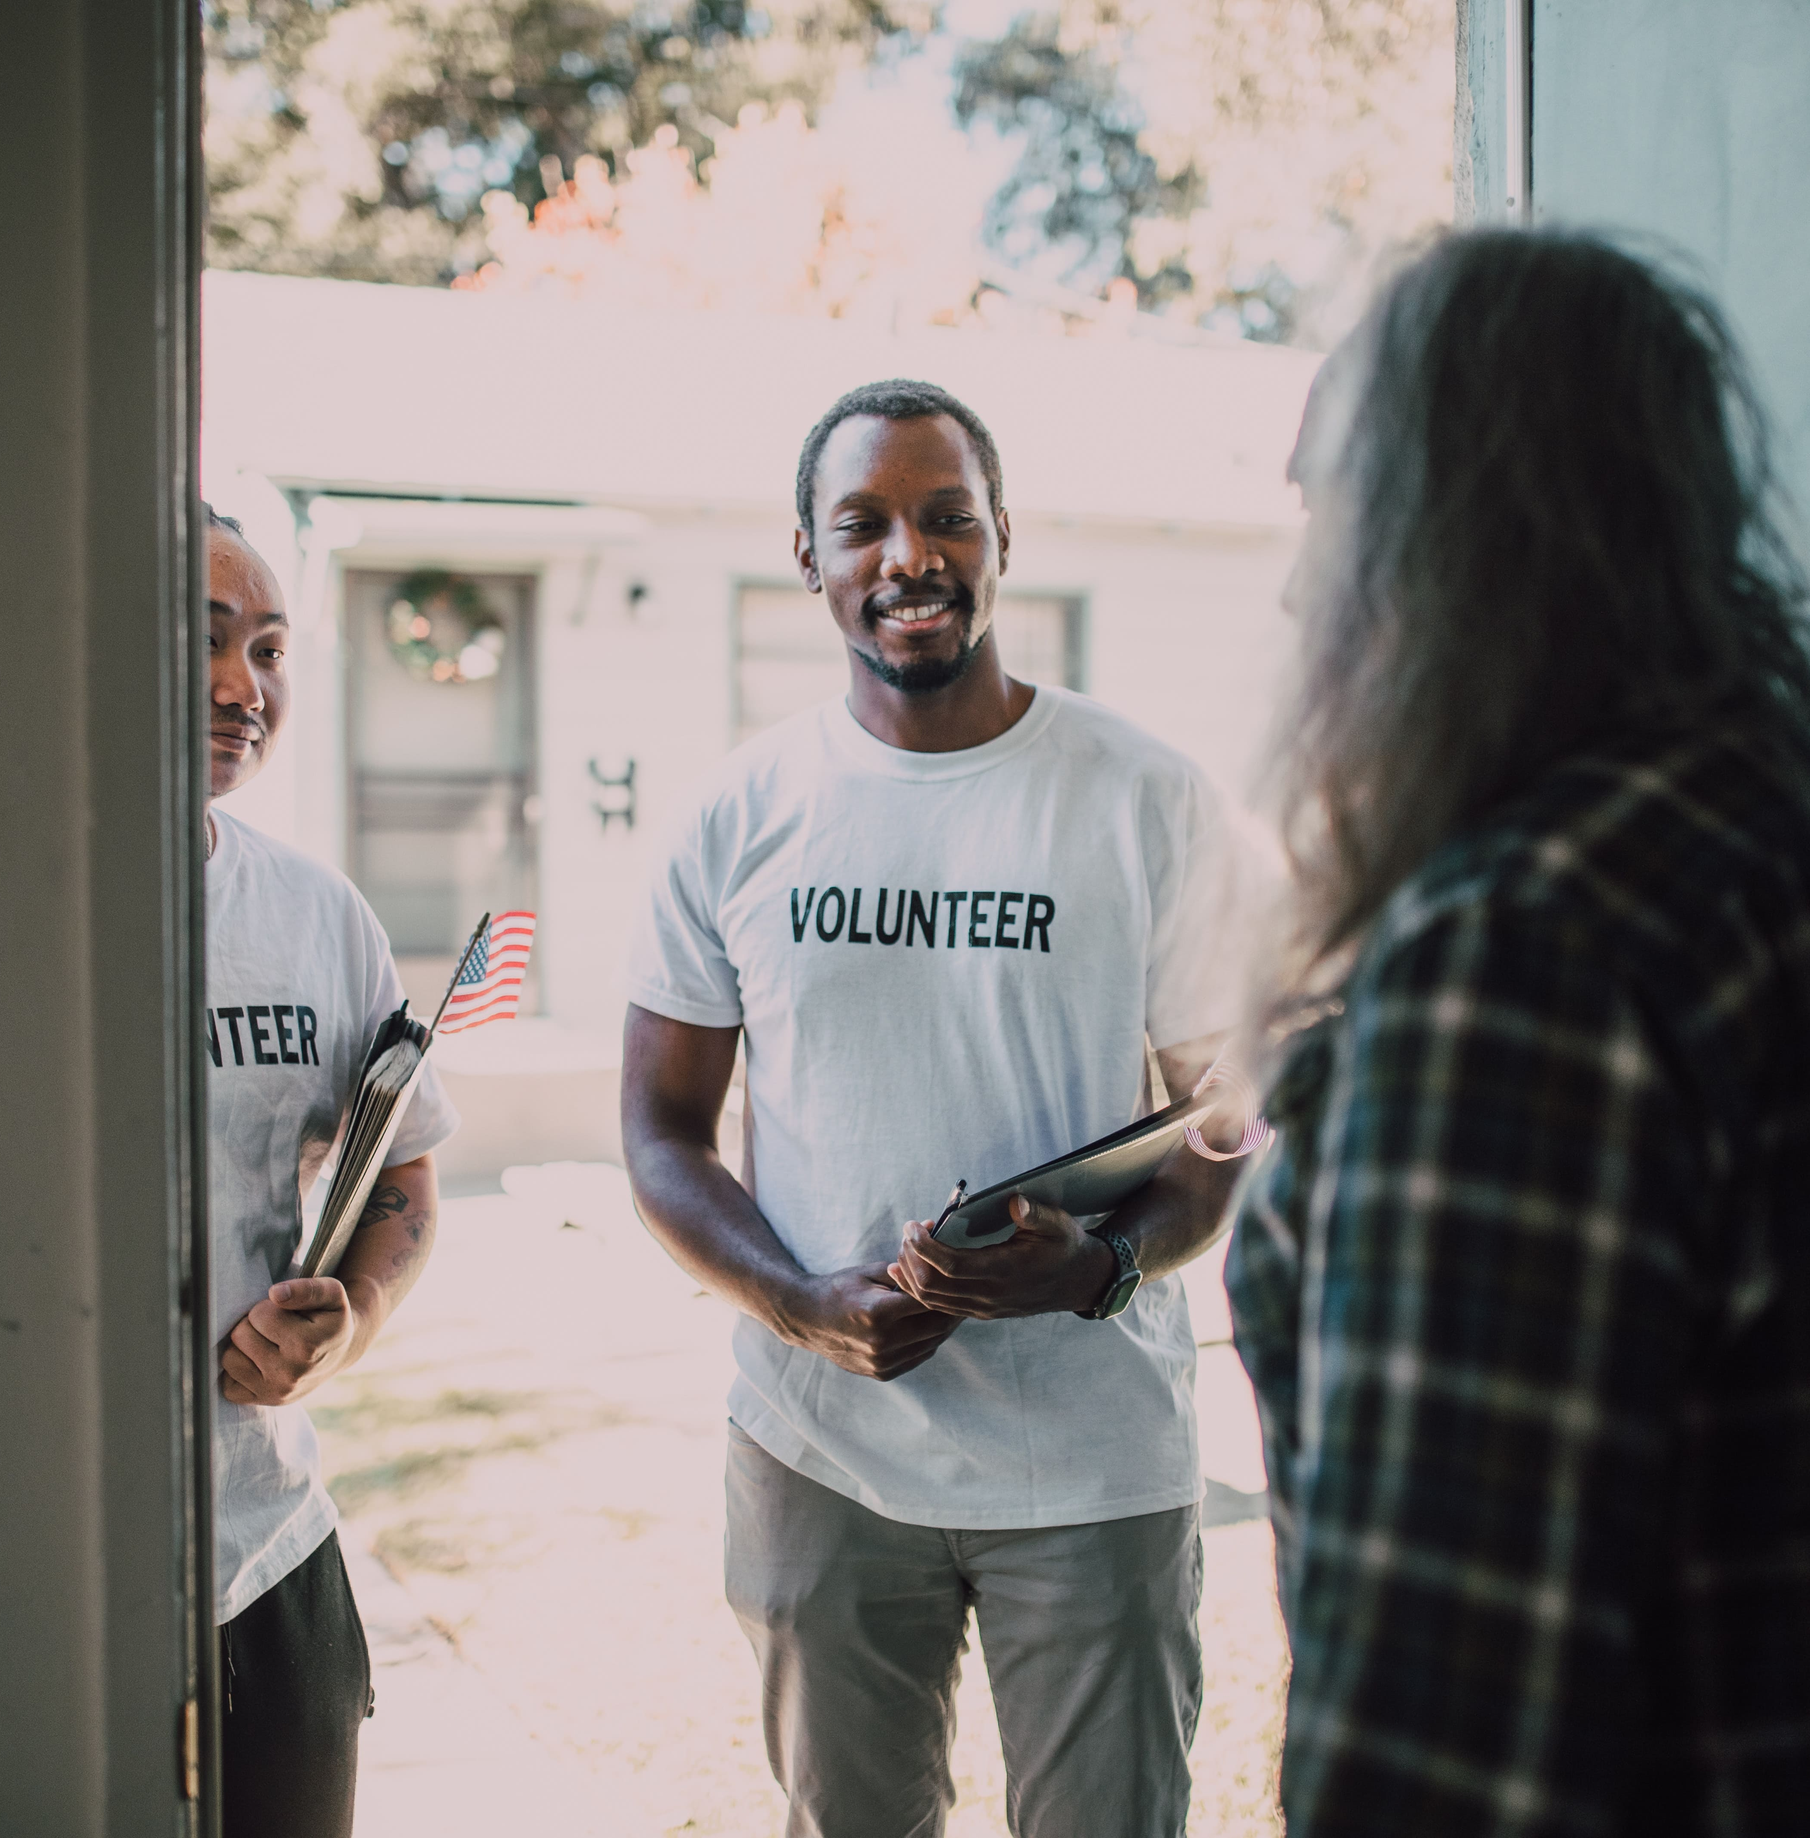
Colporteur work.
The canvassing work should be considered as sacred, and those who have unclean hands and defiled hearts should not be encouraged to enter upon it. The angels of God cannot accompany the unconsecrated to the homes of the people; therefore, all those who are not converted, whose thoughts are corrupt, who will leave the taint of their imperfections upon everything they touch, should refrain from handling the truth of God.—The Review and Herald, May 20, 1890

Slide 11
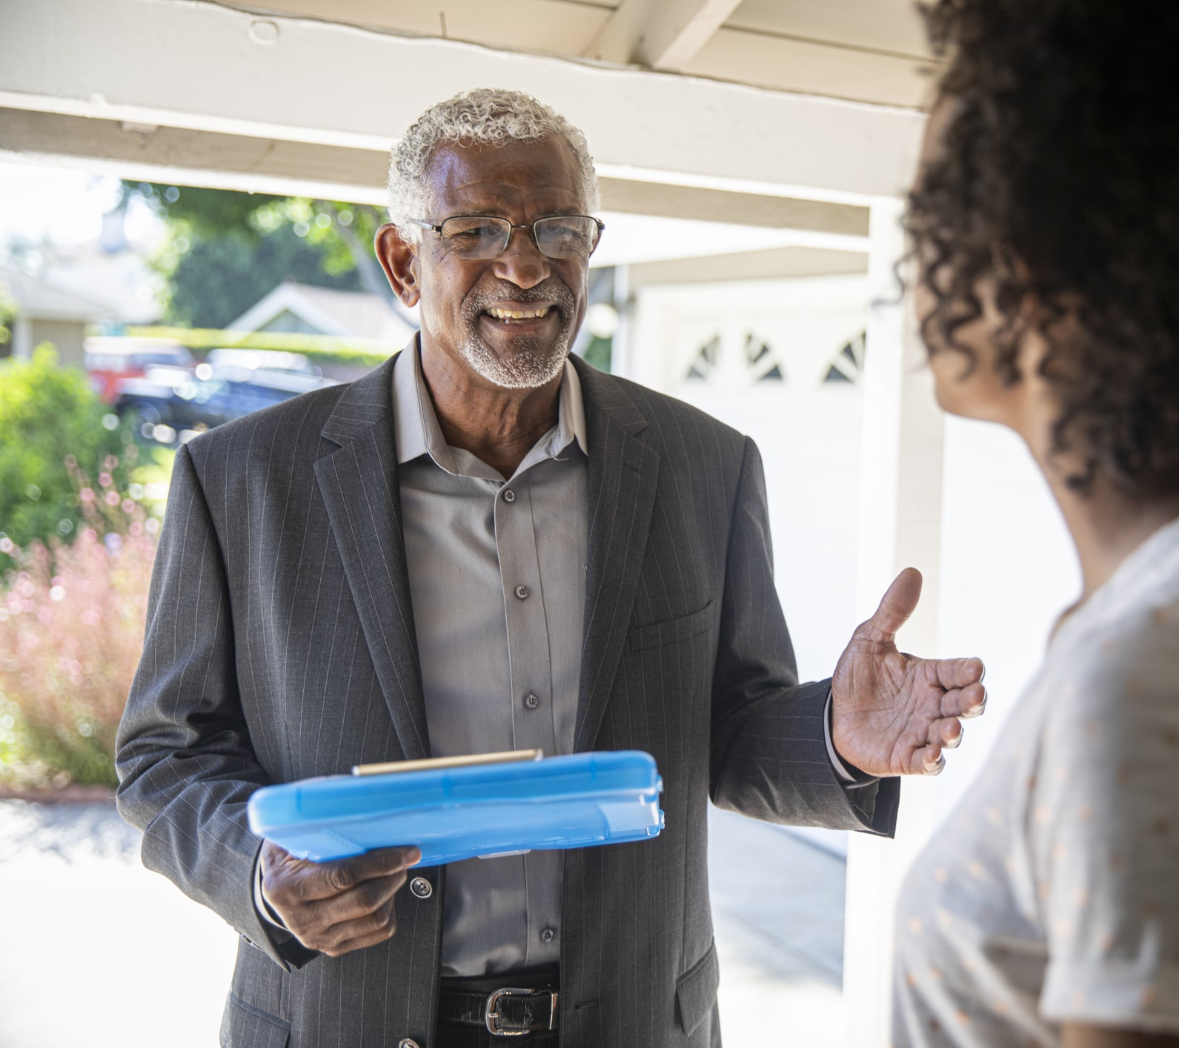
Canvassing Work
The canvassing work, properly conducted, is missionary work of the highest order, and it is as good and successful a method as can be employed for placing before the people the important truths for this time. The importance of the work of the ministry is unmistakable; but many who are hungry for the bread of life have not the privilege of hearing the word from God's delegated preachers.

Slide 12
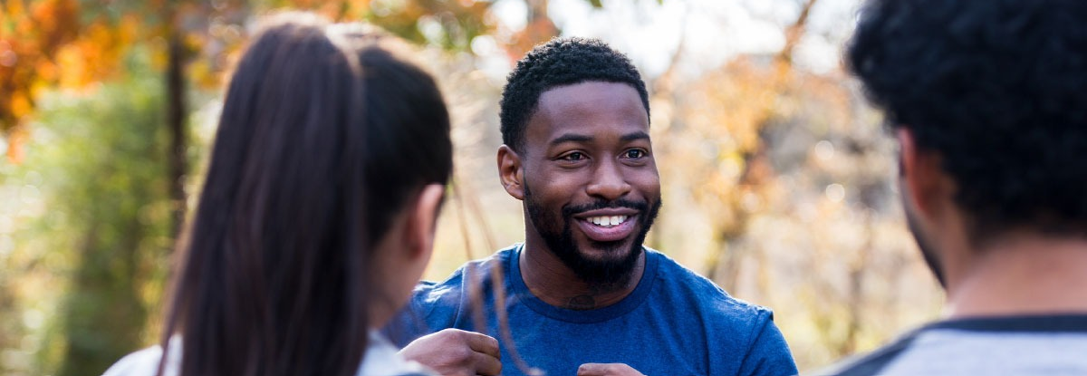
Canvassing Work
For this reason, it is essential that our publications be widely circulated. Thus, the message will go where the living preacher cannot go, and the attention of many will be called to the important events connected with the closing scenes of this world's history. {CM 6.1}

Slide 13
Canvassing Work - Testimony
I try to set a team goal everyday, and usually we get it. Today I asked for 60. Was it possible? of course. Fast forward to the end of the day, after counting we had 54. Brittany remembered we had to go to Walmart to get some cashews real quick. While she was inside 4 of us (including me) decided to canvass the parking lot. A young man bought a Peace Above the Storm from me, then I met another individual that was familiar with SDA's but didn’t know much, I showed him Great Controversy and he got it! When Brittany came back, we came together and asked each other how many books each of us got out. It was 6. Coincidence? I think not. We serve a loving God:)

Slide 14
Canvassing Work- Testimony
I went into a business and initially when I canvassed one of the workers, he said he was not going to get any of our books. I assured him that was fine and proceeded to asked if he had any prayer requests. He told me to pray for his family because many of them were lost. He continued and told me how he had been thinking about those who had not the knowledge of God and wondered if God would spare their lives because of their ignorance. God is a Just God. Just as his Character is God WILL without a doubt have mercy on them. Continued…

Slide 15
Canvassing Work -Testimony
We then spoke about the soon coming of our Saviour. I believe that our conversation gave him hope for the future. I left the store and as I was walking the Holy Spirit pressed so heavily on my heart to turn around and give him the GC for free. Heeding to his voice I Marched back and said "I have a gift for you!" and he joyfully said "I have a gift for you too!" He received the Great Controversy with gladness and appreciation and gave me a donation.

Slide 16
Canvassing Work
2 points to this Testimony:
Listen the of the HOLY SPIRIT.
Canvassing is about ministering to the people. If you've canvassed and this wasn't the aim, you've missed the point.

Slide 17
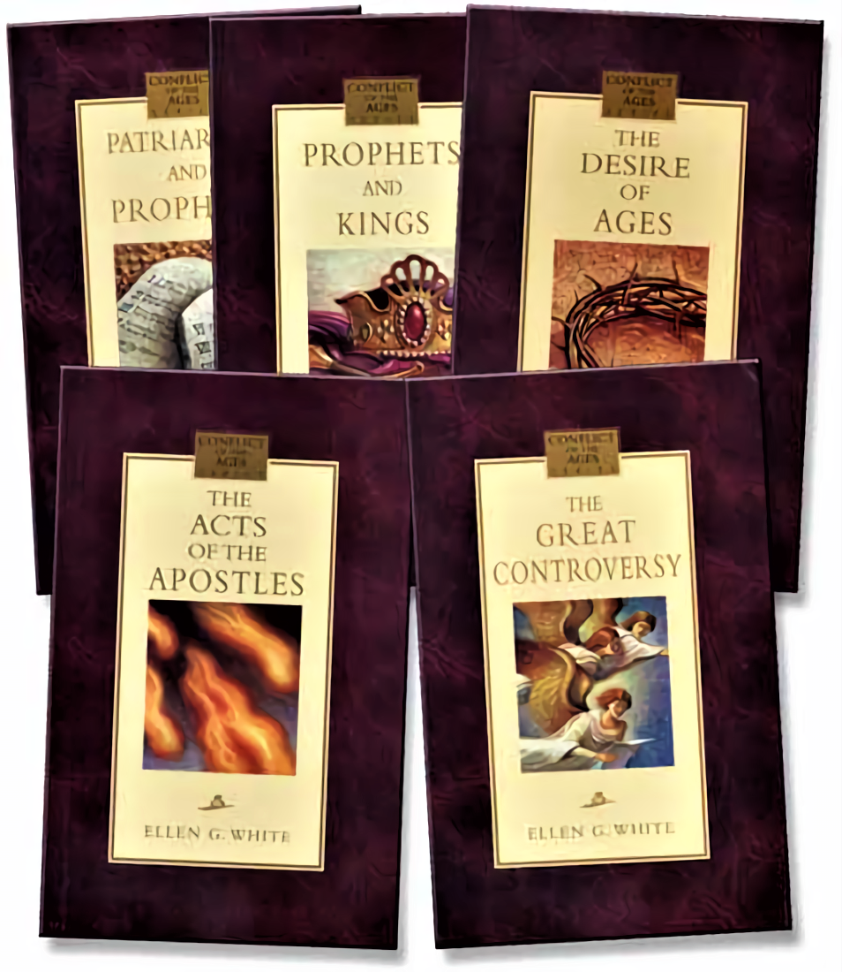
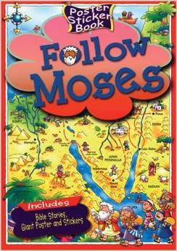
Student Canvassing Work
While canvassing, students carry our distinct Adventist literature door to door, including Spirit of Prophecy books, cookbooks, children's books, and health books.

Slide 18
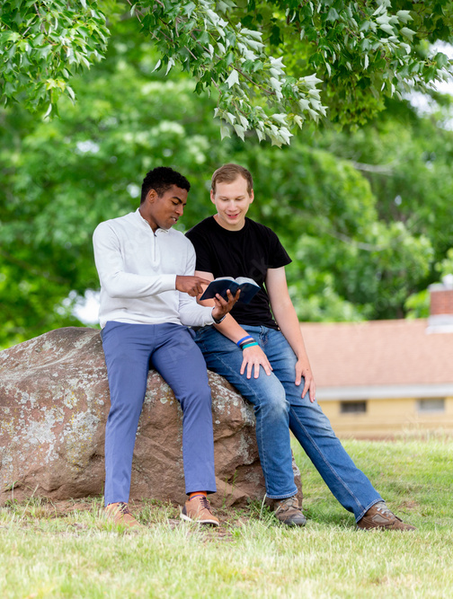
Student Canvassing Work Skill Benefits
Students are trained by experienced canvassing leaders to canvass houses, apartments, business, parking lots, and neighborhoods. Canvassers gain tremendous faith-building experiences that help them become better equipped for missionary service in the Lord's vineyard. Canvassers also learn valuable skills in preaching, public speaking, leading out in worship, drawing people into spiritual conversations, and healthful cooking.

Slide 19
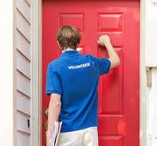
Student Canvassing Work-Skill Benefits
Students who are accepted into the program will be required to read Steps to Christ, Colporteur Ministry and portions of The Great Controversy in order to help them better understand their duties as canvassers. Students are also required to memorize their canvass before arriving on-site for the program. Upon acceptance into the program, students will receive additional instructions and expectations. The program will also include bible classes and spiritual insights for the students.

Slide 20
Colporteur work.
3. Read the Colporteur Evangelist and the Colporteur Ministry by Ellen White. This is work is being neglected because we distaste door to door work, but we are not to let 'feelings' get in the way. In about 6 months one worker had over 50 contacts interested in various programs and 29 Bible studies by 'cold' door knocking in a town in Canada (not the easiest place to witness).

Slide 21
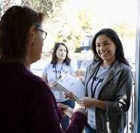
Colporteur work.
The beauty of colporteuring is because you are offering a 'sale’, People are very interested in health and children's materials so you have something they WANT.

Slide 22
Canvassing Safety
• Be prepared, not scared: Regularly assess risks, seek available training and support, including advice from local police, parties, or council, and trust your instincts for personal safety during canvassing to ensure a confident and secure approach.
• Focus on group safety: Whenever possible, canvass in groups or pairs for safety – and because it is more enjoyable! Inform others of your whereabouts if canvassing alone.
• Actively communicate with the team and set periodic check-ins: Share canvassing plans with the team and trusted contacts, establishing regular check-ins for safety.

Slide 23
Canvassing Safety
• Use technology to make canvassing safer: Use available technological aids like wearable devices and tracking apps for mobile phones. Get familiar with their emergency features to enhance safety while canvassing.
• Be security aware: Prioritise safety and security when canvassing. Try carrying only essentials and avoid going into residents’ homes.
• Keep a record: Maintain a detailed incident log and report any uncomfortable situations encountered while canvassing. Sharing incident reports with both your party and the council/police ensures appropriate awareness and action.

